Slide 1
Hackathon day 4
OBJECTIVE:
The main goal of Day 4 was to add Functionality ,dynamic routing so users can view different car details. I also focused on improving the website's design (UI) and making sure it works well on all devices (responsiveness).

Slide 2
Step 1: Update the Schema in Sanity: Added a slug field to the car schema in Sanity. Defined the slug field as a type of slug with the option to automatically generate it from the car's name. Step 2: Modify the Query File: Updated the query in the query.ts file to include the slug field. Ensured that the query fetches the slug along with other car details such as name, brand, price, etc.

Slide 3
Step 3: Updated the script file: to include logic for generating and handling the slug field. Added validation and error handling to ensure the slug is correctly created and used
Step 4: Verify in Sanity Studio: Checked the Sanity Studio to ensure the slug field is visible for each car entry. Ensured the slug field is populated correctly with a URL-friendly version of the car’s name as shown below.

Slide 4
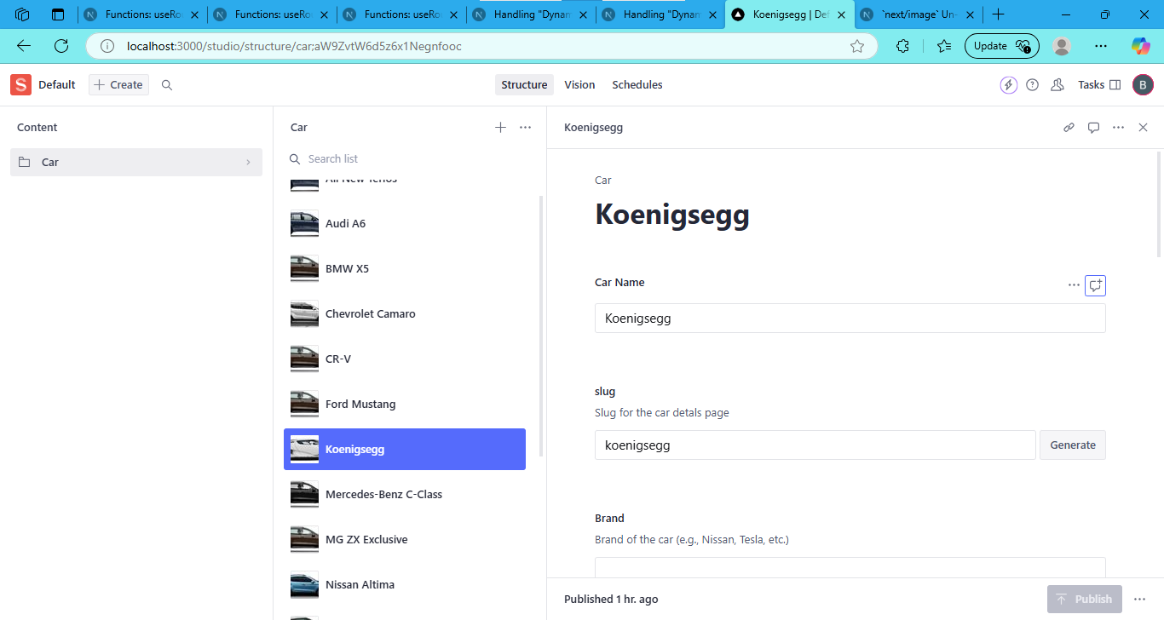
Captured a snap of sanity showing the slug field in car entries

Slide 5
ADDING DYNAMIC ROUTING : Step 1: Set up the dynamic routing in the frontend using [slug].tsx. Step 2: Fetch the slug data dynamically from Sanity.

Slide 6
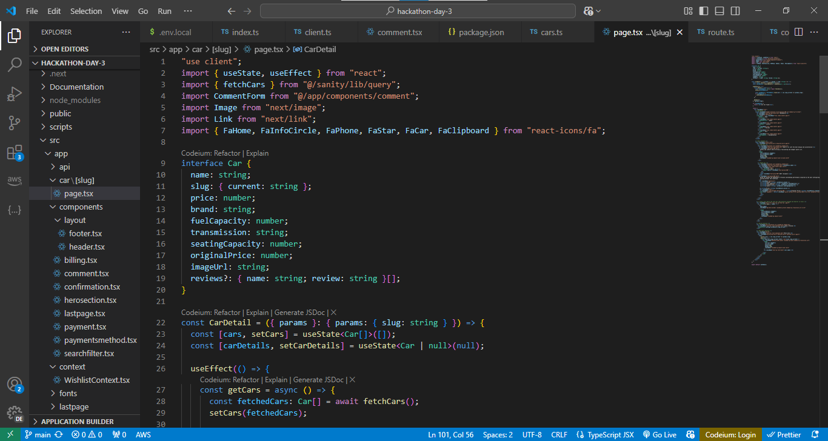
[slug].tsx

Slide 7
Step 3: Display the content of the selected card on the details page. Step 4: Test the dynamic routing functionality to ensure each card loads its specific details.

Slide 8
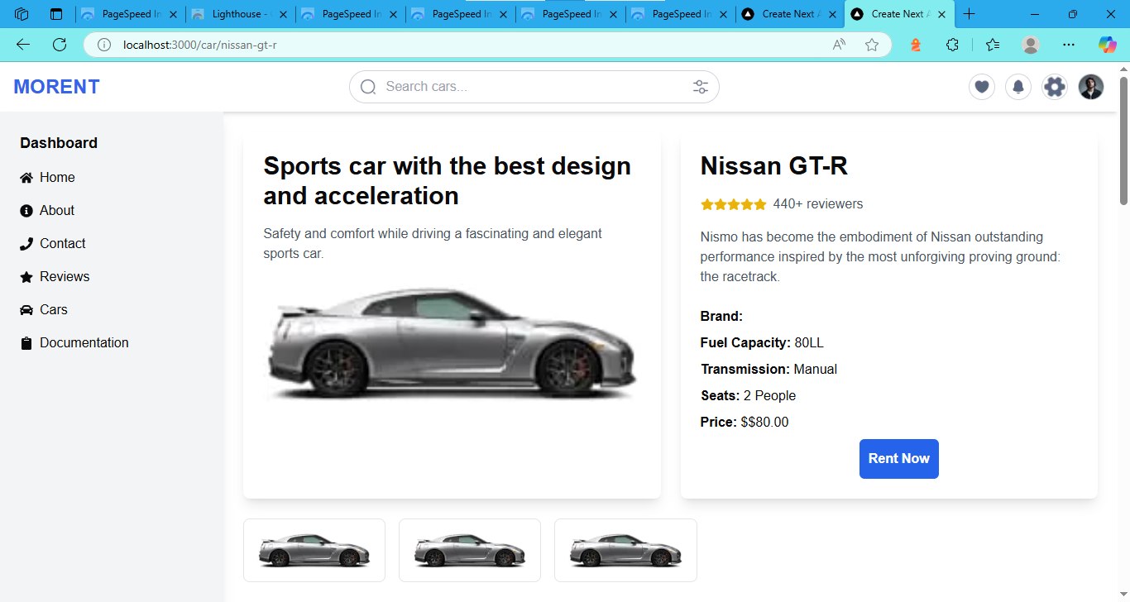
Dynamic pages

Slide 9
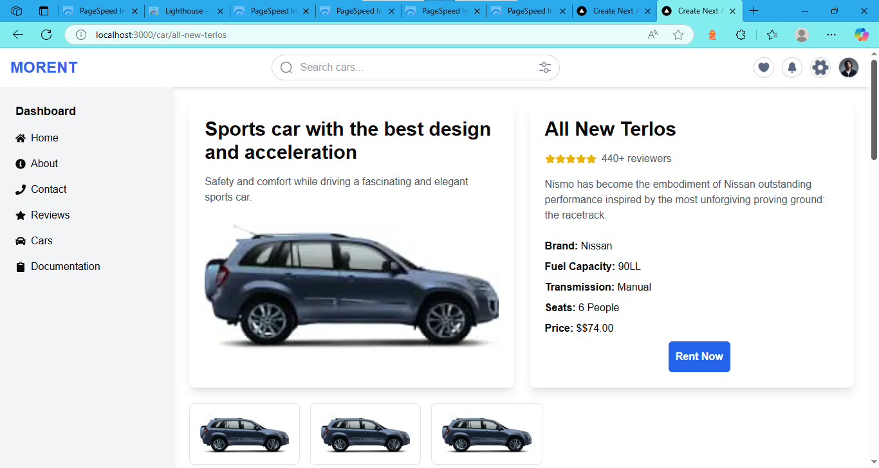

Slide 10
To enhance user experience, I implemented an Add to Wishlist feature in my car website project. This functionality allows users to save their favorite cars for easy access later. The implementation involved the following steps: 1. Wishlist Context:I created a wishlistcontext.tsx file to manage the state of the wishlist globally using React Context.This file ensures that the wishlist data is accessible across all relevant components.
Add to wishlist functionality

Slide 11
2. Wishlist Detail Page: A dedicated route was created for the Wishlist Detail Page. This page displays all the cars added to the wishlist, providing users with a seamless browsing experience. This feature improves the website's usability by offering a personalized and convenient way for users to keep track of their preferences.

Slide 12
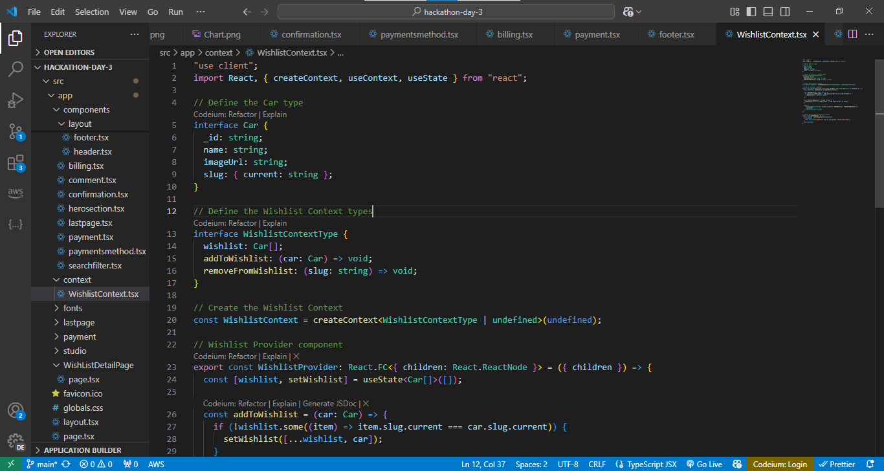
Wishlist Context.tsx

Slide 13
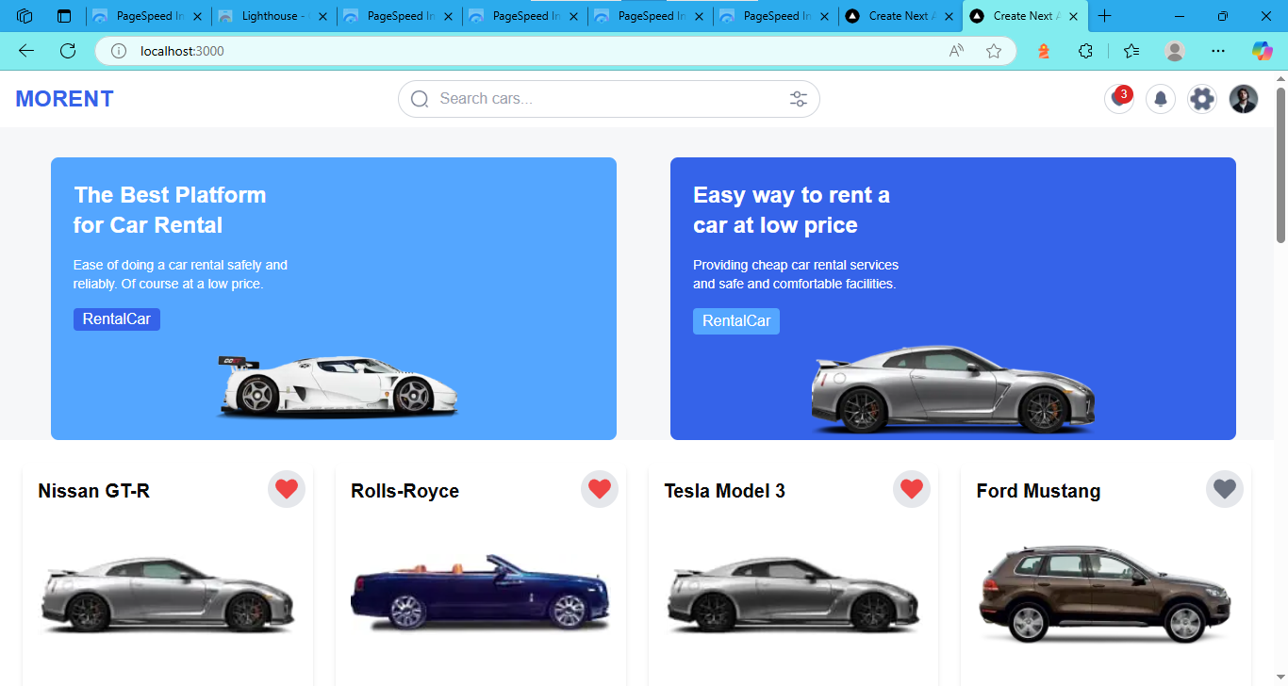

Slide 14
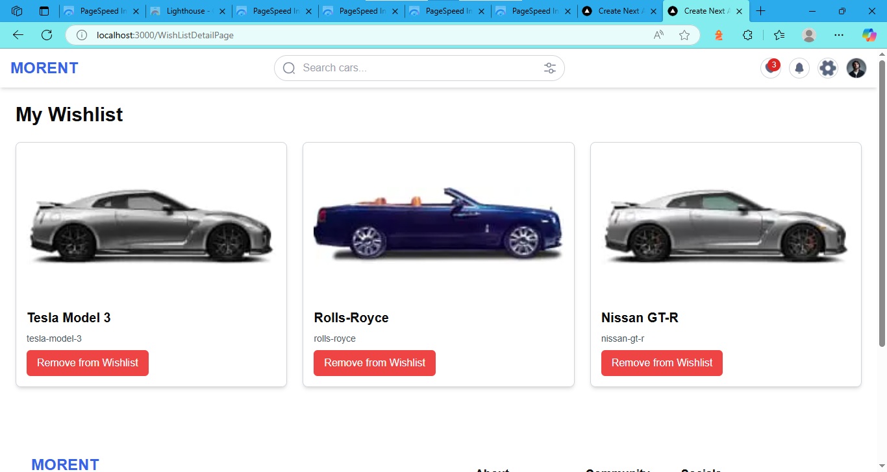
Users can also remove cars from wishlist by clicking on this button

Slide 15
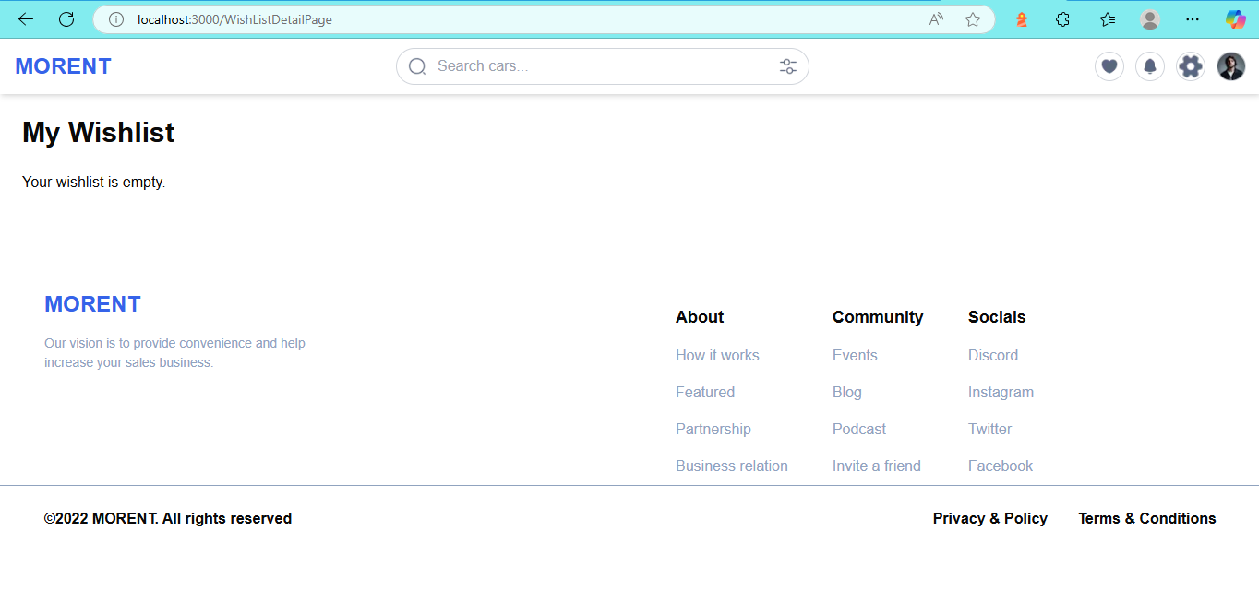
When wishlist is empty the page displaying a message as shown below

Slide 16
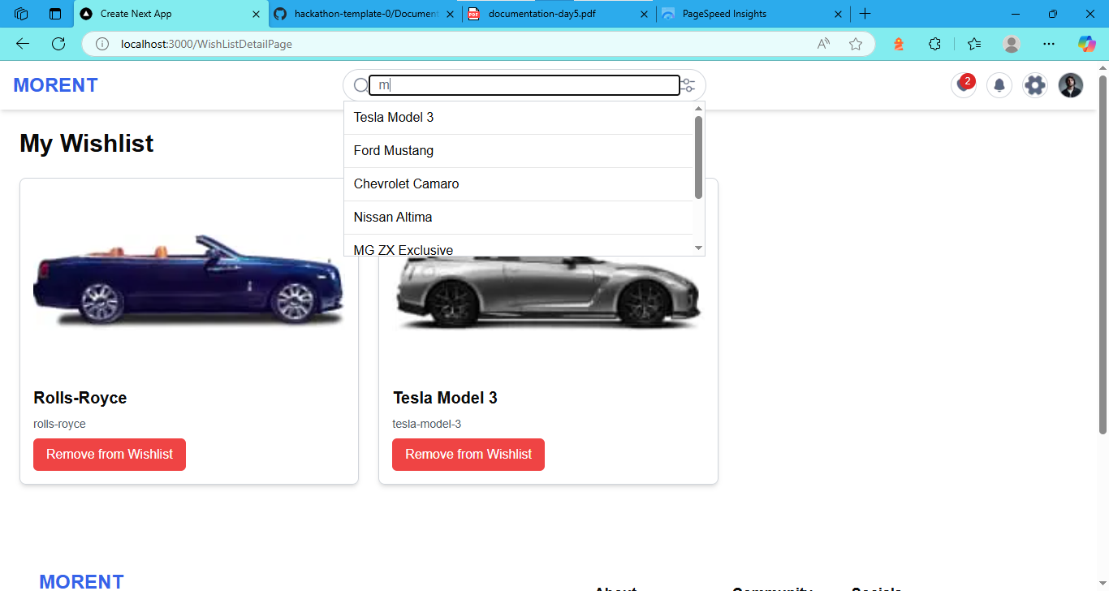
Search bar Functionality
“A dynamic search filter in my car's website enables users to quickly find their desired destinations or points of interest. As users type, the filter automatically refines search results in real-time. This feature reduces the time spent searching for locations and provides a seamless navigation experience. With dynamic search filtering, drivers can focus on the road while effortlessly finding their desired routes.“
prepared by :Bisma Naeem

